Slide 1
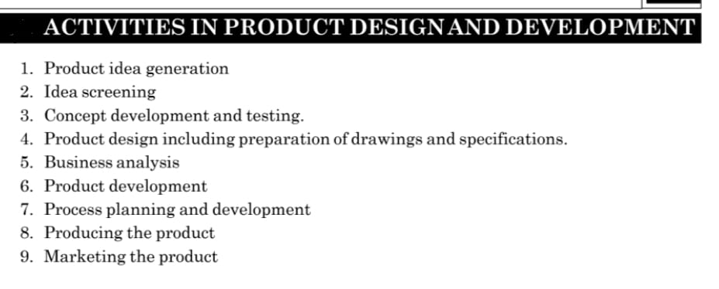

Slide 2
Product Idea Generation
conceptualization of ways to improve existing products or create new ones to meet customer needs happens during the idea generation, stage.
Teams can use different techniques for coming up with product ideas, such as brainstorming.
Ideas are collected from competitors, by inventions, from dealers and customers’

Slide 3
Idea screening
Not all new product ideas that surface during the early stages of product development are viable.
Idea screening can provide important validation for a product idea .
Selected ideas are evaluated technically as regards to the method of manufacture, labour and equipment required, performance of product and cost of the of manufacture.
Teams can conduct market research to evaluate a product idea, determining, for instance, whether it meets a market need and would appeal to potential customers.

Slide 4
Concept development or concept testing
In this stage, the product idea evolves into a product concept: something that a company can present to target audiences for gauging customer feedback.
This presentation can take the form of a detailed description or a prototype that demonstrates the feasibility of the product vision but with more limited functionality.
Develop the method for production using simplification, standardization and specialization techniques.
Finalise the requirements of the equipment needed for manufacture
Finalise the specification of the material required.
Job requirement of the worker and their training.
System for exercising the control is evolved.

Slide 5
The goal of the prototyping phase during product development is to create a finished product to use as a sample for mass production.
Prototyping usually involves experimenting with several versions of your product, slowly eliminating options and making improvements until you’re satisfied with a final sample.

Slide 6
Marketing strategy
Marketing is often associated with product messaging, social media and marketing campaigns geared toward target markets.
But a marketing strategy could also include sales and market share goals and product pricing and distribution strategy, among other facets.
Business analysis
Will the product under development be good for business? This is determined during the business analysis stage, where teams calculate projections for sales, costs and profits.

Slide 7
Test marketing
Companies may choose to roll out the product in a limited fashion in specific markets before engaging in a wider product launch.
In traditional test marketing, sales results are compared among multiple cities for a duration of six months to a year.
What product development teams learn from user feedback during test marketing can lead to adjustments in marketing strategy.
Commercialization
The commercialization stage entails the mass production of the product and the introduction of the final product to the general market—in other words, the official, scaled product launch.

Slide 8
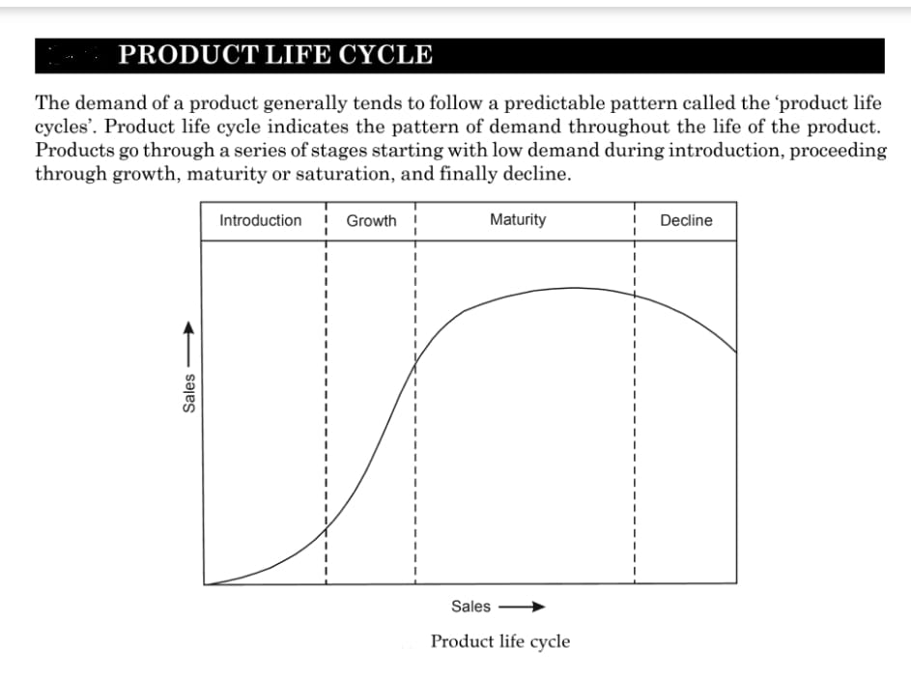

Slide 9
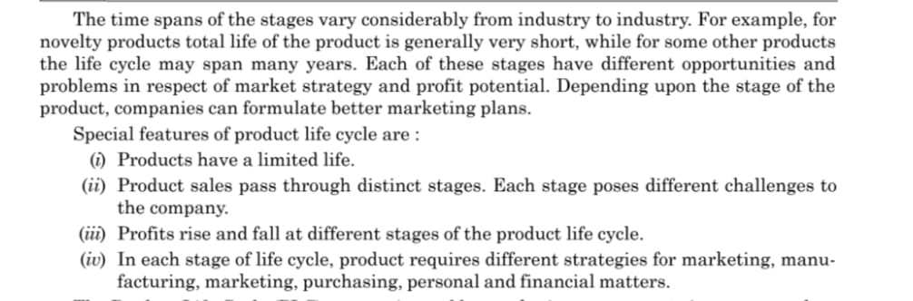

Slide 10
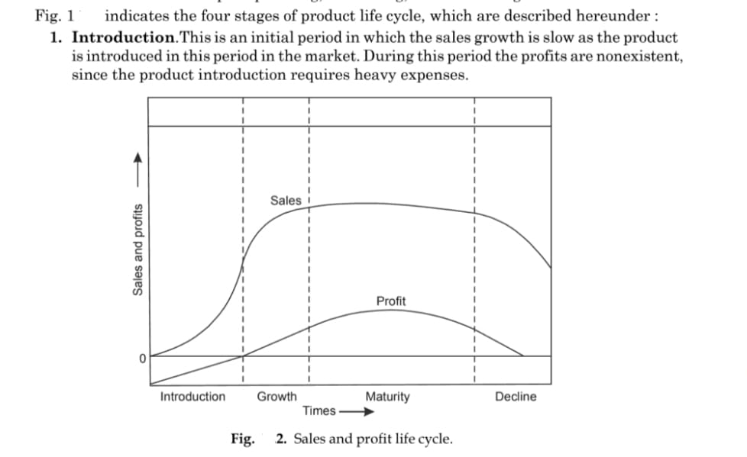

Slide 11
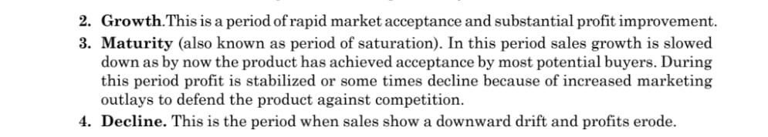

Slide 12
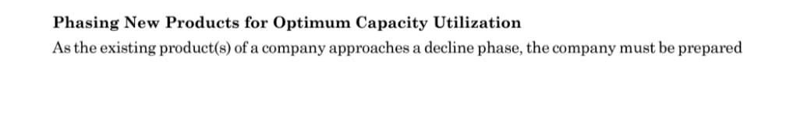

Slide 13
